Slide 1
RELATIONAL ALGEBRA
Objectives
Understand the meaning of symbols used in relational algebra.
How to form queries in relational algebra.
Relational Algebra

Slide 2
Introduction
Relational algebra : is a theoretical language with operations that work on one or more relations to define another relation without changing the original relation(s).
Informally, relational algebra is a (high-level) procedural language; can tell the DBMS how to build a new relations from other relations in the database.
Relational Algebra is a basis for other Data Manipulation Languages for relational databases-illustrates the basic operations required for any DML.
Relational Algebra

Slide 3
Relational Algebra
5 basic operations in relational algebra:
Selection, Projection, Cartesian product, Union, and Set Difference.
These perform most of the data retrieval operations needed.
Also have Join, Intersection, and Division operations, which can be expressed in terms of 5 basic operations.
Relational Algebra

Slide 4
Relational Algebra Operations cont’d
These operations can be categorised into two groups; unary and binary operations.
Unary Operations: These operate on one relation. Examples of unary operations include; selection and projection
Binary Operations; These work on pairs of relations. Examples include the; Cartesian product, union, set difference, join, intersections and division operations
Relational Algebra

Slide 5
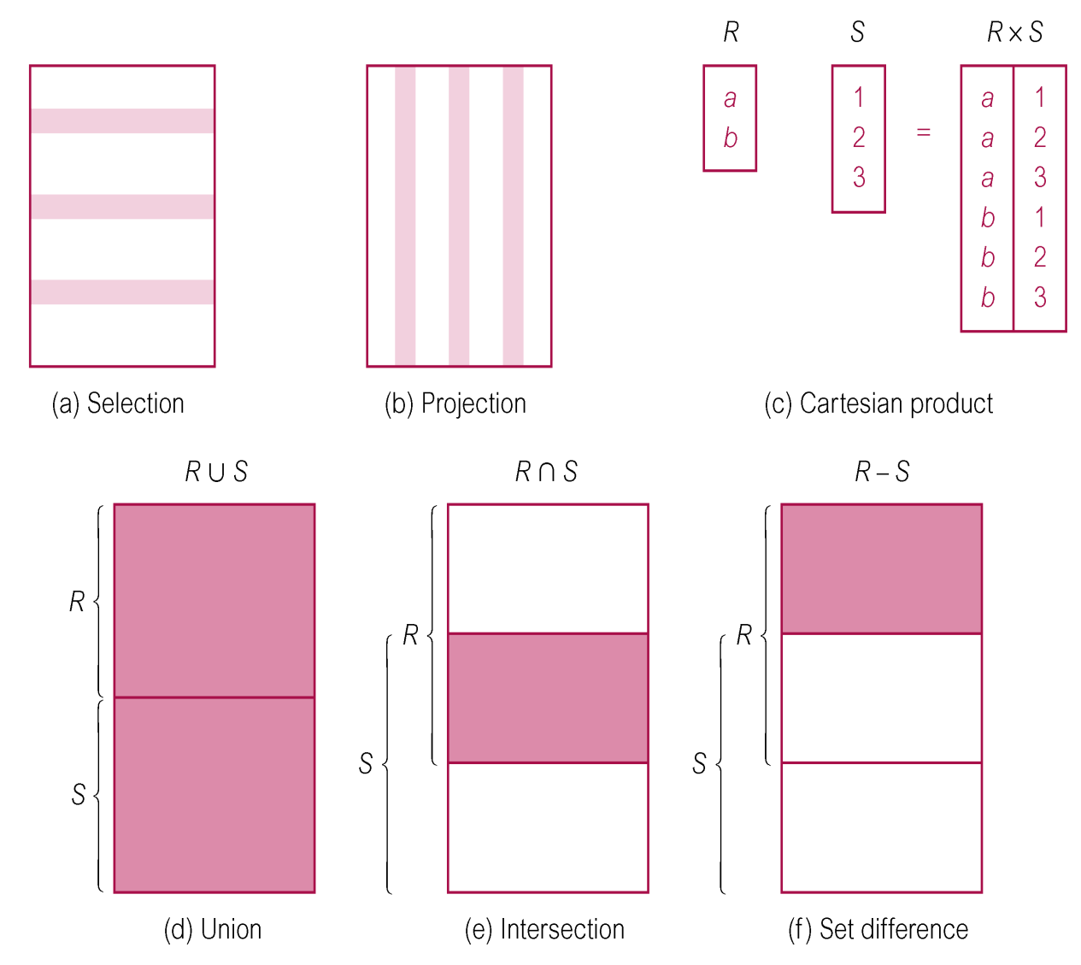
Relational Algebra Operations
(illustrations showing the functions of the relational algebra operations)
Relational Algebra

Slide 6
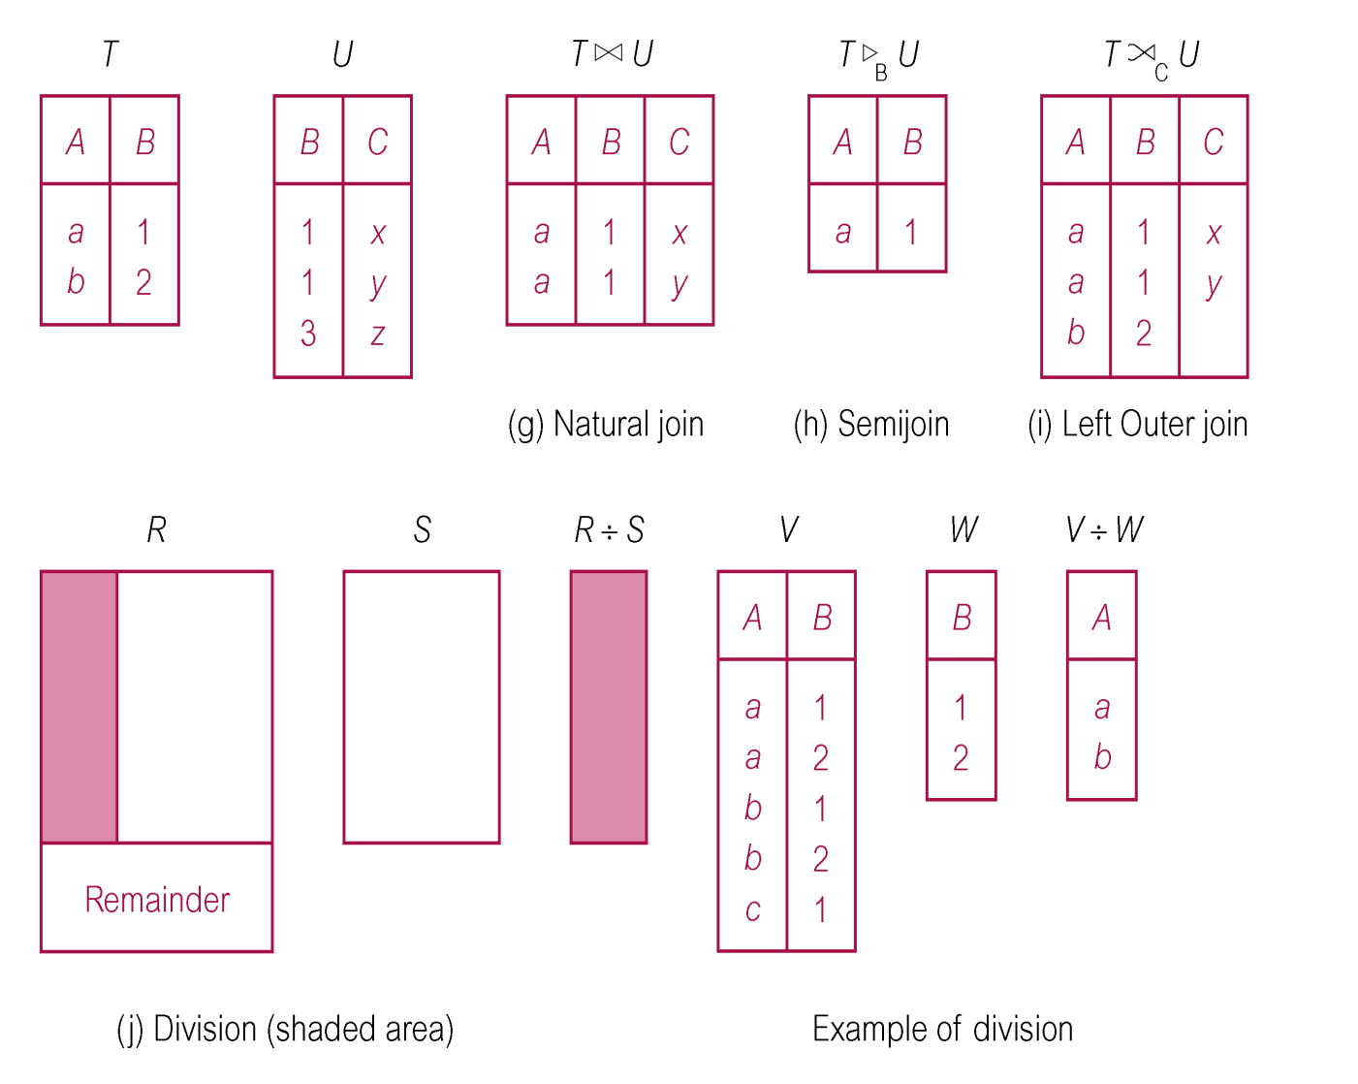
Relational Algebra Operations
Relational Algebra

Slide 7
Selection (or Restriction)‏
σ_{predicate} (R)‏
Purpose : Picks rows according to some criteria.
  Works on a single relation R and defines a relation that contains only those tuples (rows) of R that satisfy the specified condition (predicate).
  More complex predicates can be generated using the logical operators; Λ (AND), ν (OR) and ~ (NOT)‏
  Eg;
  σ salary>10000 AND σ SALARY <2000 (Staff)
Relational Algebra

Slide 8
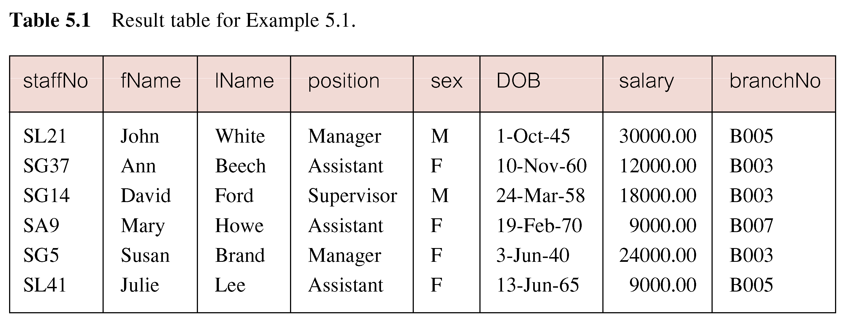

Relational Algebra

Slide 9
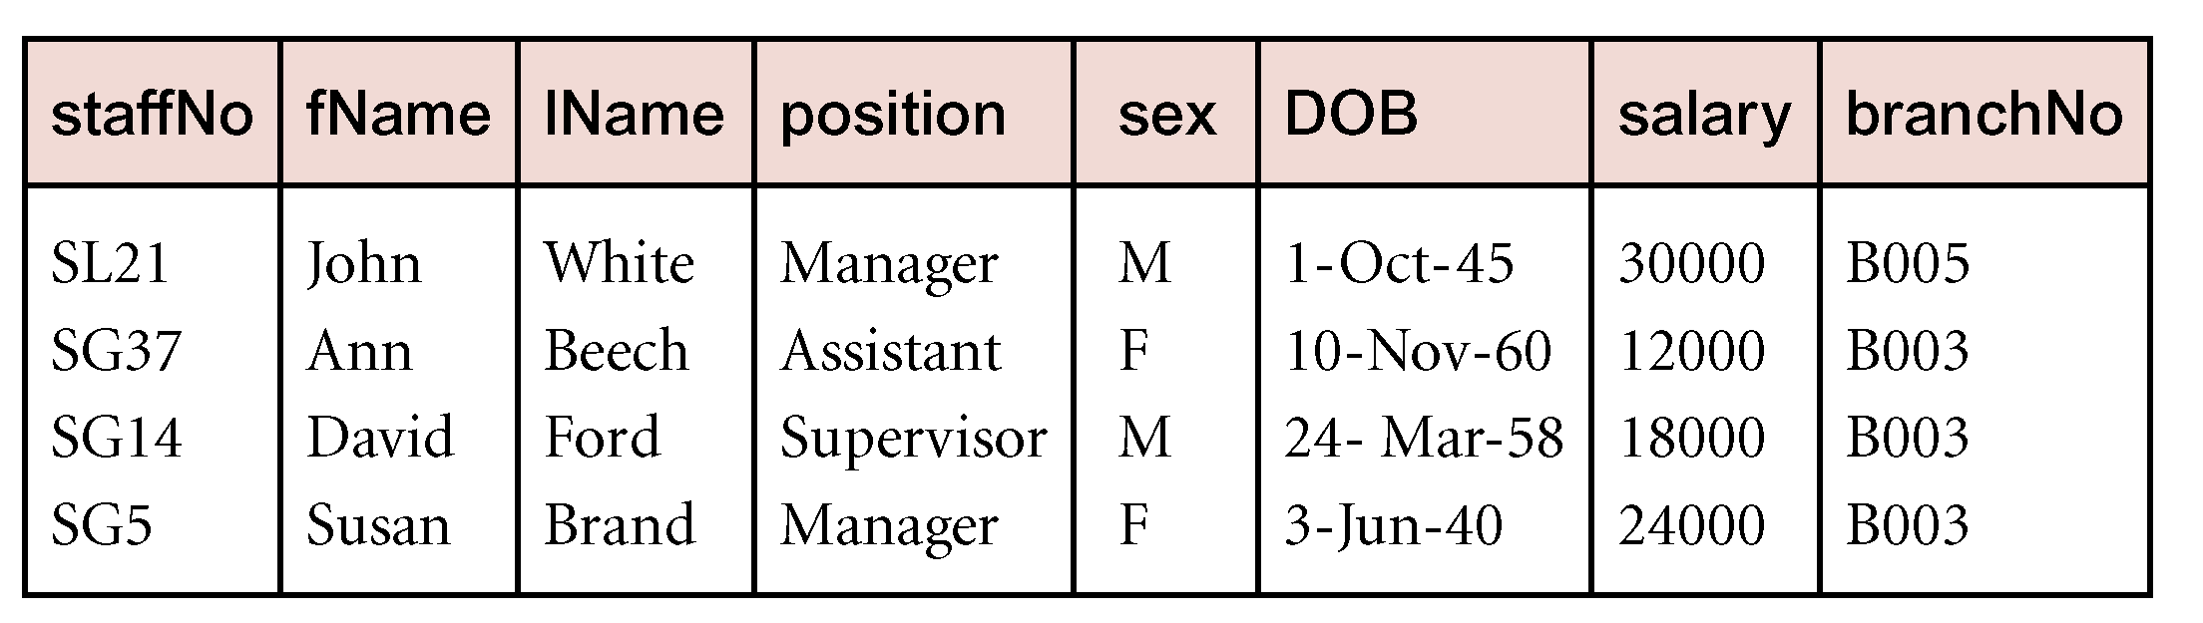
Example - Selection (or Restriction)‏
List all staff with a salary greater than £10,000.
  σ_{salary > 10000} (Staff)‏
Relational Algebra

Slide 10
Projection
Purpose : Picks some of the attributes of the relation.
Π_{col1, . . . , coln}(R)‏
  Works on a single relation R and defines a relation that contains a vertical subset of R, extracting the values of specified attributes and eliminating duplicates.
  For example : Picking Reg No’s and all names of students.
Relational Algebra

Slide 11
Example - Projection
Produce the names and respective marks from student table
  Π_{fName, marks}(Student)‏
Name | Age | Regno | Marks
Peter | 19 | S09b13/311 | 80
Sam | 20 | S09b13/230 | 75
Mary | 21 | S09b13/567 | 65
Name | Marks
Peter | 80
Sam | 75
Mary | 65
Relational Algebra

Slide 12
Union
R ∪ S
  Union of two relations R and S defines a relation that contains all the tuples of R, or S, or both R and S, duplicate tuples being eliminated.
  (Union) is the relation containing all tuples that appear in R1, R2, or both
If R and S have I and J tuples, respectively, union is obtained by concatenating them into one relation with a maximum of (I + J) tuples.
Relational Algebra

Slide 13
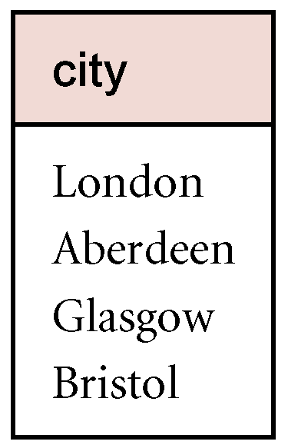
Example – Union
The union of two relations R and S defines a relation that contains all the tuples of R, or S, or both R and S, duplicate tuples being eliminated.
List all cities where there is either a branch office or a property for rent.
  Π_{city}(Branch) ∪ Π_{city}(PropertyForRent)‏
  Make use of Connolly & BEGG
  Page 80. PropertyForRent &
  Branch Table.
Relational Algebra

Slide 14
Set Difference
R – S
  Defines a relation consisting of the tuples that are in relation R, but not in S.
Relational Algebra

Slide 15
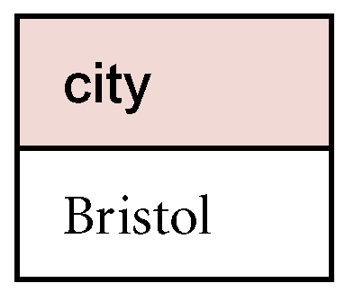
Example - Set Difference
List all cities where there is a branch office but no properties for rent.
  Π_{city}(Branch) – Π_{city}(PropertyForRent)‏
Relational Algebra

Slide 16
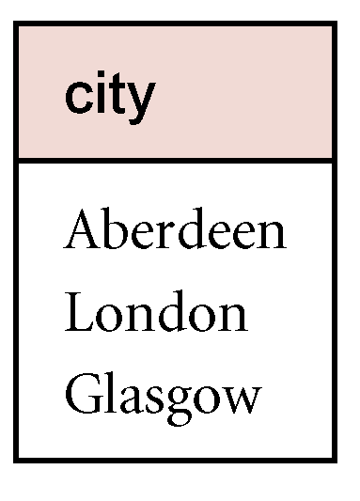
Intersection ( And )
R ∩ S
  Defines a relation consisting of the set of all tuples that are in both R and S.
List all cities where there is both a branch office and at least a property for rent.
  Π_{city}(Branch) ∩ Π_{city}(PropertyForRent)
Relational Algebra

Slide 17
Cartesian product
Purpose: Pairs rows from 2 tables.
R X S
  Defines a relation that is the concatenation of every tuple of relation R with every tuple of relation S; relation with all possible pairs of tuples from the two relations.
  In case the relations have attributes with the same names, these are prefixed with the relation name to maintain the uniqueness of attribute names in the resulting relation.
  Output: For each row r in R and each row s in S, output a row rs; the output table has the columns of R and the columns of S
  Note we can express the intersection operation in terms of set difference. R n S=R-(R-S)
Relational Algebra

Slide 18
Example - Cartesian Product
List the names and comments of all clients who have viewed a property for rent.
  (Π_{clientNo, fName, lName}(Client)) X (Π_{clientNo, propertyNo,comment} (Viewing))‏
Relational Algebra

Slide 19
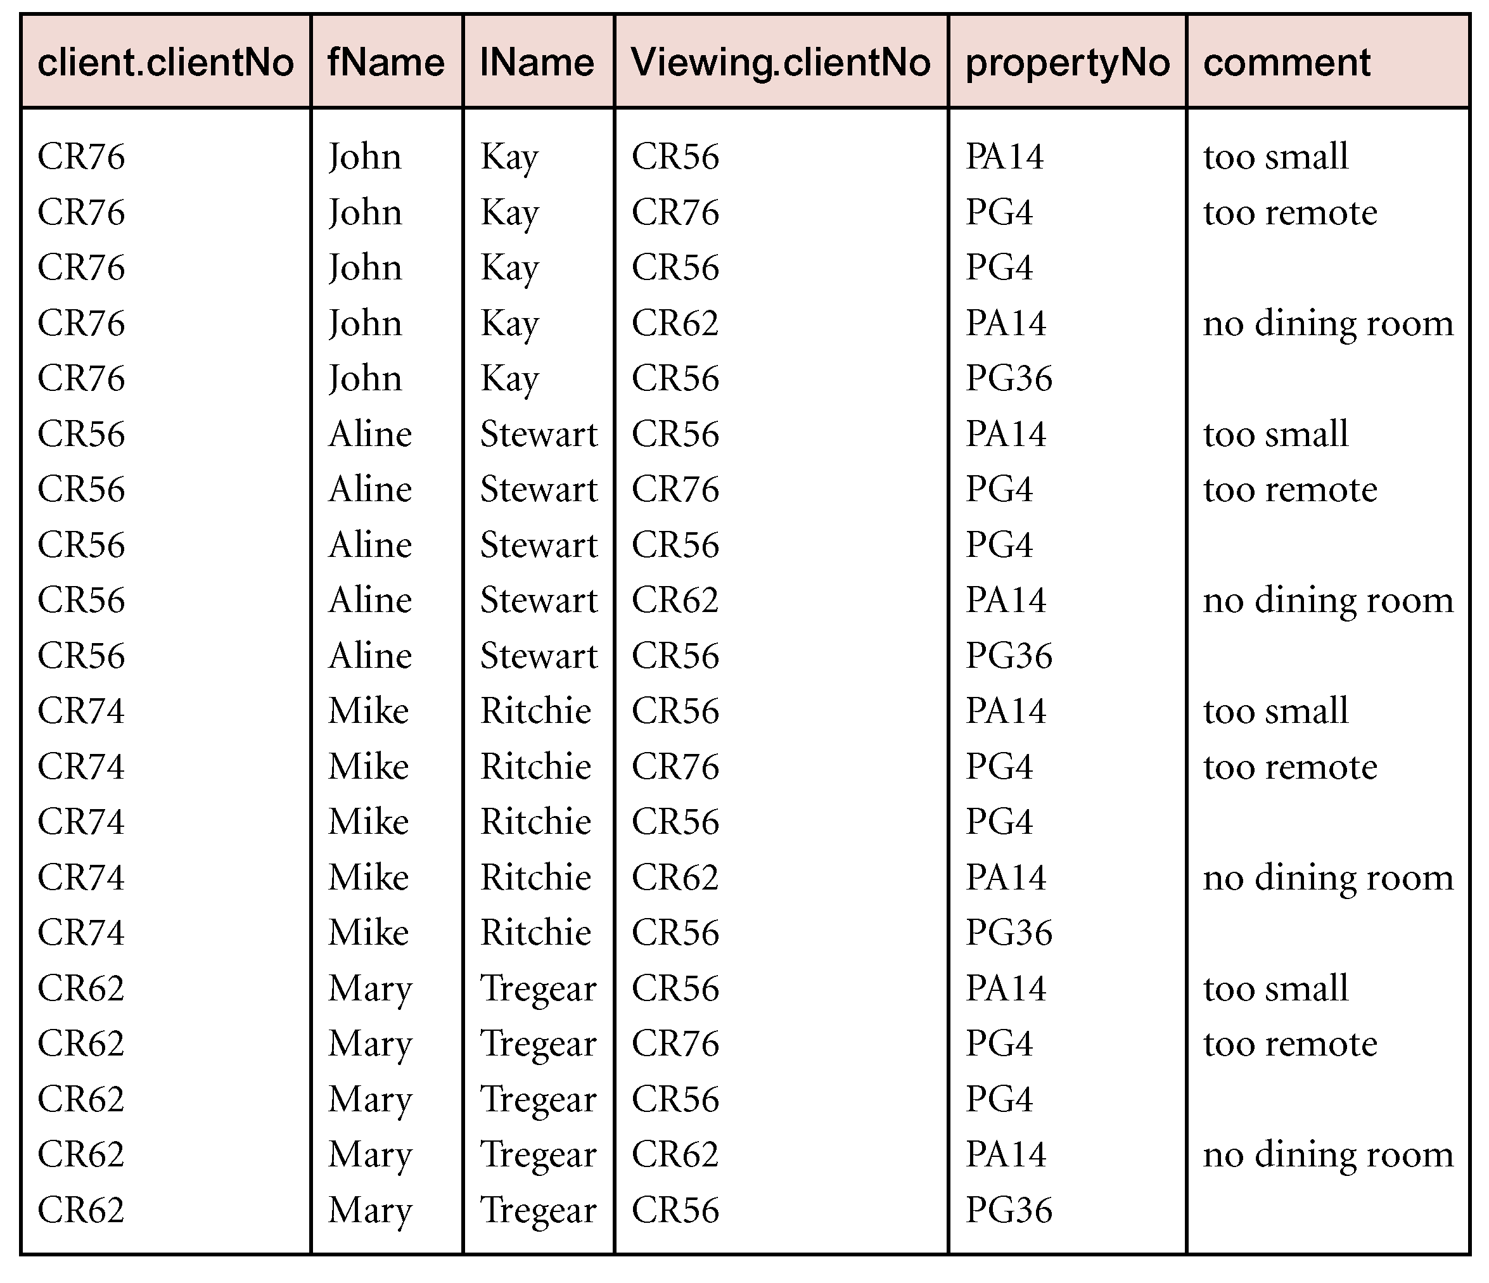
Example - Cartesian Product cont’d
Relational Algebra

Slide 20
Join Operations
This is one of the essential operations in relational algebra; a join operation combines two relations to form a new one.
A Join is a derivative of Cartesian product; Equivalent to performing a Selection, using join predicate as selection formula, over Cartesian product of the two operand relations (Cartesian product that satisfies a given condition(s)).
One of the most difficult operations to implement efficiently in an RDBMS and one reason why RDBMSs have intrinsic performance problems.
Relational Algebra
Notes:
N.B: In reality we are usually interested only in combinations of the cartesian product that satisfies certain conditions. These are commonly known as join operations rather than restricted cartesian products.

Slide 21
Join Operations
Various forms of join operation
  Theta join
  Equi -join‏
  Natural join
  Outer join
  Left Outer Join
  Right Outer Join.
Relational Algebra

Slide 22
Theta join (θ-join)‏
R _{F}S
  Defines a relation that contains tuples satisfying the predicate F from the Cartesian product of R and S.
  The predicate F is of the form R.a_{i} θ S.b_{i} where θ may be one of the comparison operators (<, ≤, >, ≥, =, ≠).
Relational Algebra

Slide 23
Theta join (θ-join)‏
Can rewrite Theta join using basic Selection and Cartesian product operations.
    R _{F}S = σ_{F}(R Χ S)‏
Degree of a Theta join is sum of degrees of the operand relations R and S; as the Cartesian product.
If predicate F contains only equality (=), the term Equijoin is used.
Relational Algebra

Slide 24
Example Theta join
Suppose a customer wants to buy a car and boat, but doesn’t want 2 spend more money for the boat than for the car Ie CAR >= Boat Price
Car Model | Car Price
Car A | 20000
Car B | 30000
Car C | 50000
Boat model | Boat Price
Boat 1 | 10000
Boat 2 | 40000
Boat 3 | 60000
Car Model | Car Price | Boat Model | Boat Price
Car A | 20000 | Boat 1 | 10000
Car B | 30000 | Boat 1 | 10000
Car C | 50000 | Boat 1 | 10000
Car C | 50000 | Coat 2 | 40000

Slide 25
The Natural join
Determine the common attributes by looking for attributes with identical names.
Select only the rows with common values in the common attributes.
Relational Algebra

Slide 26
Example – Equijoin
Qn . Generate the resultant equi join from the Employee and Dept Table below
Employee TABLE
NAME | EMP ID | DEPT NAME
HARRY | 3415 | FINANCE
SALLY | 2241 | SALES
GEORGE | 3401 | FINANCE
HARRIET | 2202 | SALES
DEPT TABLE
DEPT NAME | MANAGER
FINANCE | GEORGE
SALES | HARRIET
PRODN | CHARLES
Relational Algebra

Slide 27
NAME | EMPID | DEPTNAME | MANAGER
HARRY | 3415 | FINANCE | GEORGE
SALLY | 2241 | SALES | HARRIET
GEORGE | 3401 | FINANCE | GEORGE
HARRIET | 2202 | SALES | HARRIET
Relational Algebra

Slide 28
Natural Join
R S
  An Equijoin of the two relations R and S over all common attributes x. One occurrence of each common attribute is eliminated from the result.
  The degree of a natural join is the sum of the degrees of the relations R and S less the number of attributes in x.
Relational Algebra

Slide 29
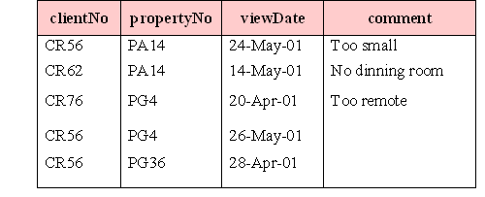
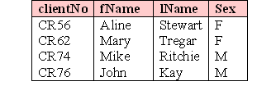
Example
VIEWING
CLIENT

Slide 30
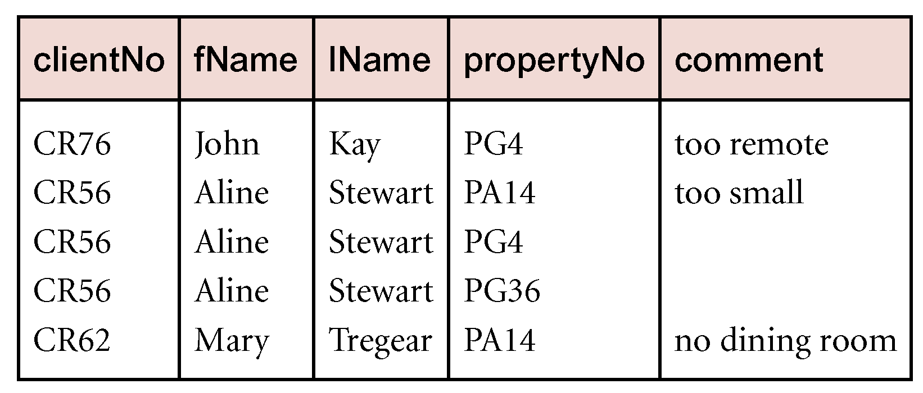
Example - Natural Join
List the names and comments of all clients who have viewed a property for rent.
  (Π_{clientNo,fName,lName}(Client)) (Π_{clientNo,propertyNo,comment}(Viewing))‏
Relational Algebra

Slide 31
Outer join
To display rows in the result that do not have matching values in the join column, use Outer join.
Advantage: preservation of information (that would otherwise be lost).
There are basically three types of outer join operations
  Left Outer join
  Right Outer join
  Full Outer join
Relational Algebra

Slide 32
Outer Join
To display rows in the result that do not have matching values in the join column, use Outer join.
R S
(Left ) Outer join is the join in which tuples from R that do not have matching values in common columns with S are also included in result relation.
R S Resultant
A | B
a | 1
b | 2
A | B | C
a | 1 | x
a | 1 | x
b | 2 | Null
B | C
1 | x
1 | y
3 | z

Slide 33
Left Outer join ( )
R S
  (Left) outer join is join in which tuples from R that do not have matching values in common columns of S are also included in result relation.
  The missing values in the second relation are set to null.
  Returns all values from the left table , plus matched values from the left table ( or Null in case of No matching join predicate)
Relational Algebra
Notes:
They maintain the concept of the natural join with the exception of including the tuples in the left hand side relation that have no matching values in the common attributes.

Slide 34
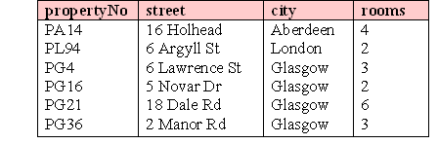
Example
PropertyForRent
Viewing

Slide 35
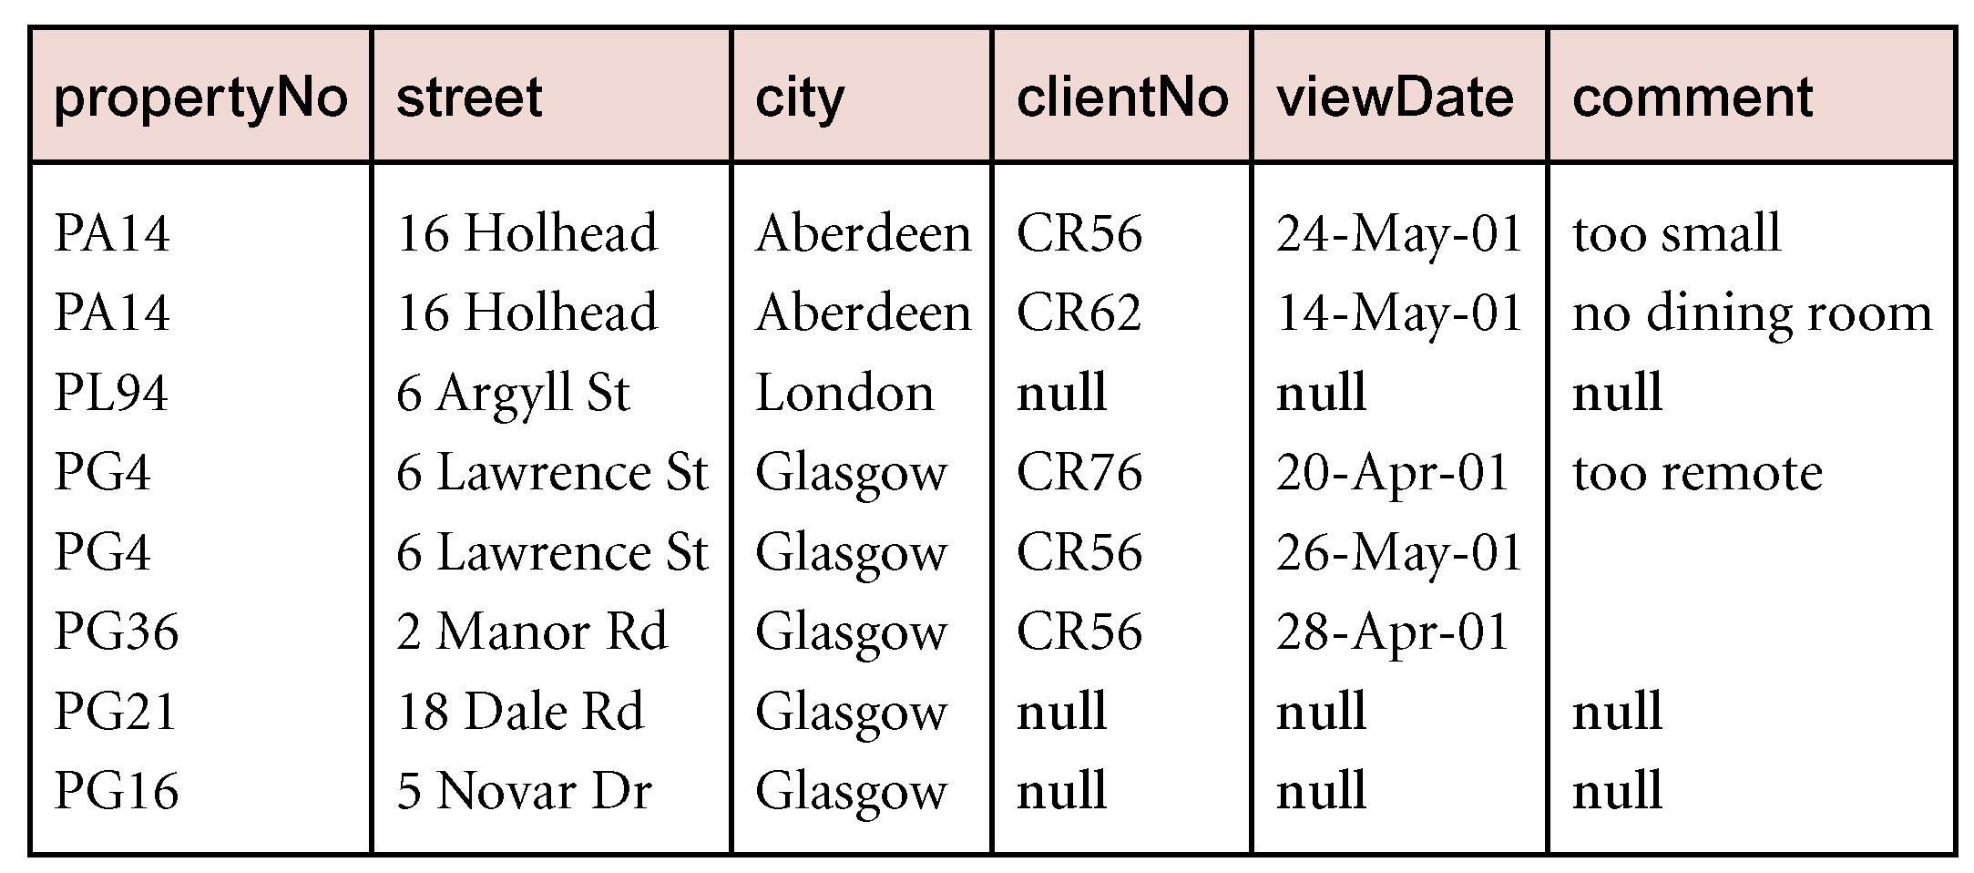
Example - Left Outer join
Produce a status report on property viewings.
  Π_{propertyNo,street,city}(PropertyForRent) Viewing
Relational Algebra

Slide 36
Outer joins cont’d
Right Outer Join:
  This join keeps all the tuples in the right-hand relation in the result.
  Returns all the values from the right table and matched values from the right table. ( Null in case of no matching join predicate)
Full Outer Join:
  Combines the result of both left and right outer join . The joined table will contain records from both tables and fill in Nulls for missing matches on either tables.
Relational Algebra

Slide 37
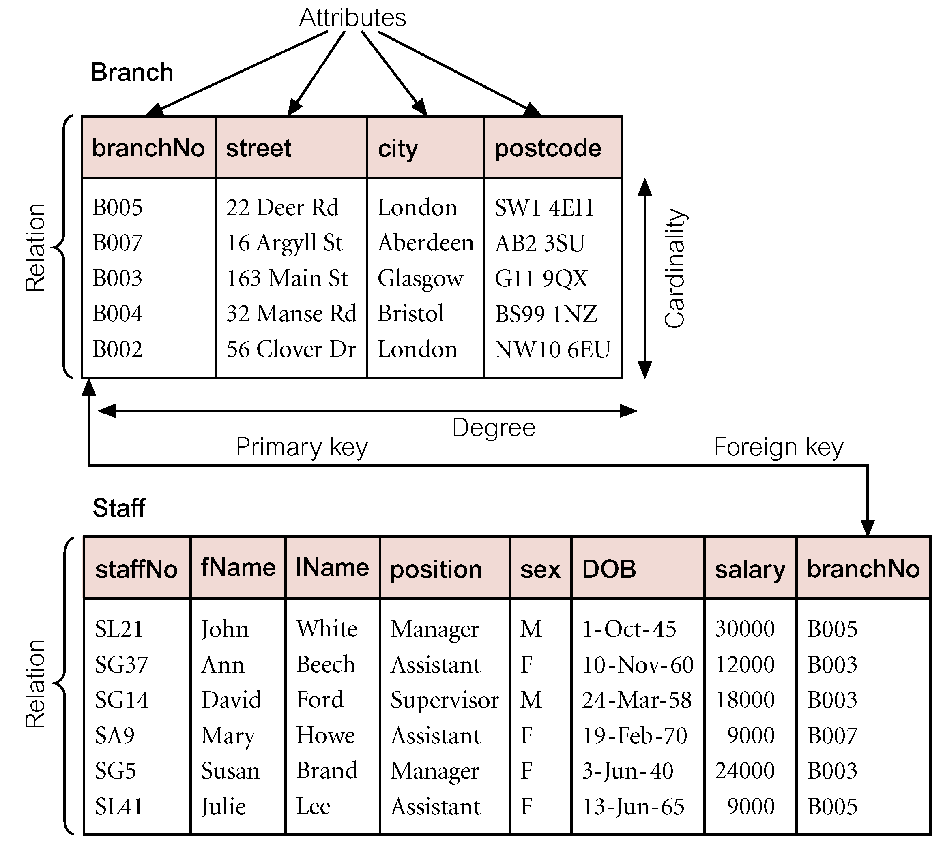
Example

Slide 38
Division (R ÷ S)
Defines a relation over the attributes C that consists of set of tuples from R (with attribute set A) that match combination of every tuple in S (with attribute set B) .
Note: C is the set of attributes of R that are not attributes of S (A-B)
Relational Algebra

Slide 39
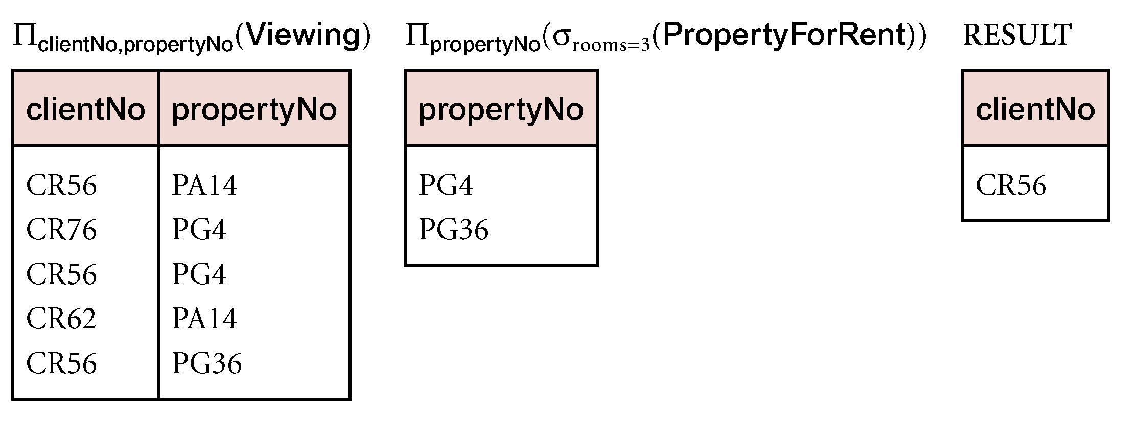
Example - Division
Identify all clients who have viewed all properties with three rooms.
  (Π_{clientNo,propertyNo}(Viewing)) ÷ (Π_{propertyNo}(σ_{rooms = 3} (PropertyForRent)))‏
Relational Algebra

